Slide 1
Phase 2 Java and Web development
CosFormulator App
Github repository: https://github.com/DenisaKo/cos_formulator
Name: Denisa Koščák
Matriculation: 9217193

Slide 2
Purpose of web app
CosFormulator is a web application designed to help cosmetic chemists to efficiently manage and develop their own formulations.
Users can input cosmetic ingredients with concentrations (percentages) and the application will dynamically calculate totals. Users will be able to save their unique formulations, allowing for easy access or modification.

Slide 3
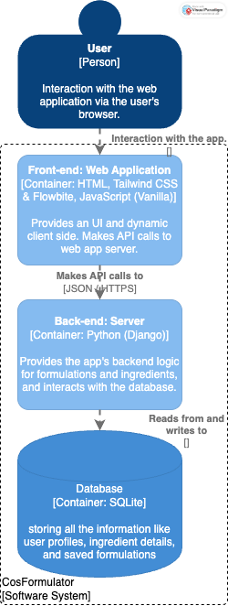
Architecture container diagram

Slide 4
Technology stack
Database
Front-end
HTML, CSS (Tailwind CSS, Flowbite),
Vanilla JavaScript for responsive UI and dynamic interactions .
Back-end
Python (Django framework) for user accounts, business logic, and API communication.
SQLite for persistent storage of users, ingredients, and formulations.

Slide 5
Changes compared to initial proposal
Tech:
Alpine.js – not used; only Vanilla JavaScript was used for dynamic interactions.
Features:
Bootstrap – replaced by Tailwind CSS and Flowbite components, as I wanted to explore modern utility-first styling.
Live percentage calculation – implemented as planned.
Dynamic addition/removal of ingredient rows within the formulation – implemented as planned.
Ingredient search/autocomplete – not implemented, as it requires users to first populate the ingredient database.
Additional Feature Implemented:
Dynamic creation of a new ingredient and saving it to the database directly during formulation creation.
Dynamic update of the ingredient selection dropdown in the formulation form after a new ingredient is created.
No feedback suggestion about change received
My changes applied
User authentication

Slide 6
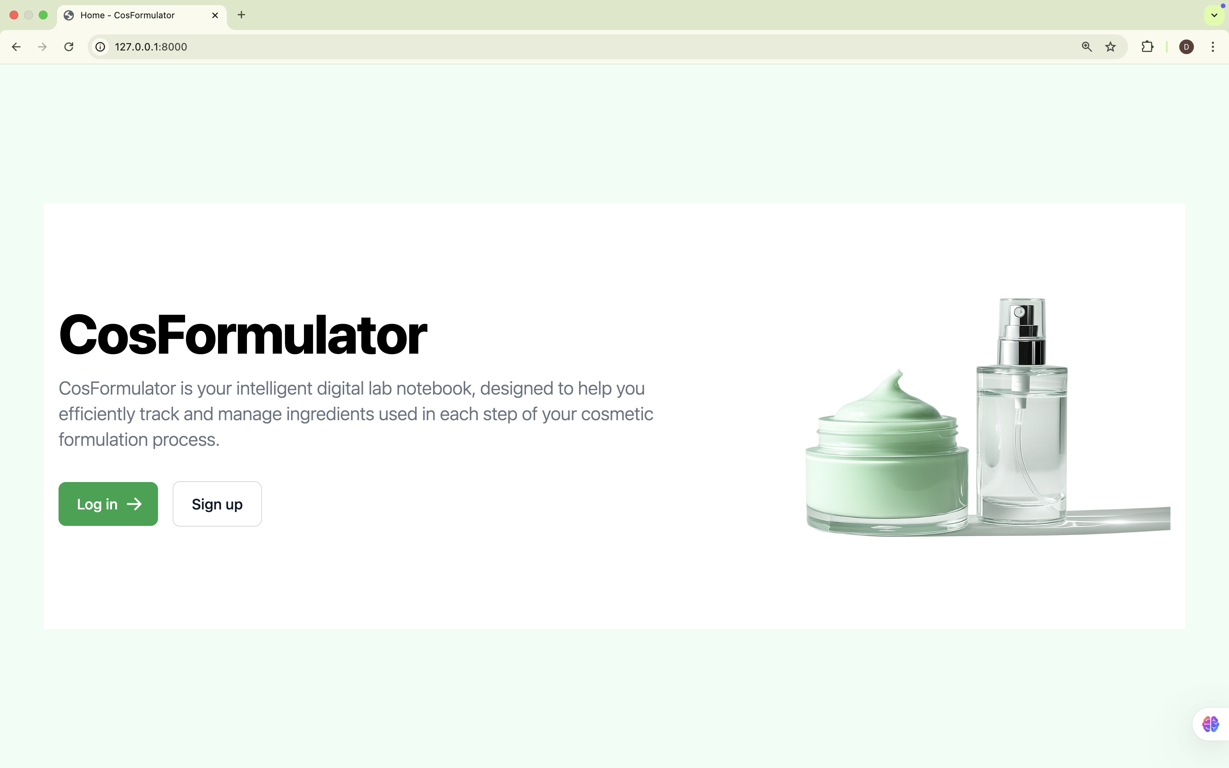
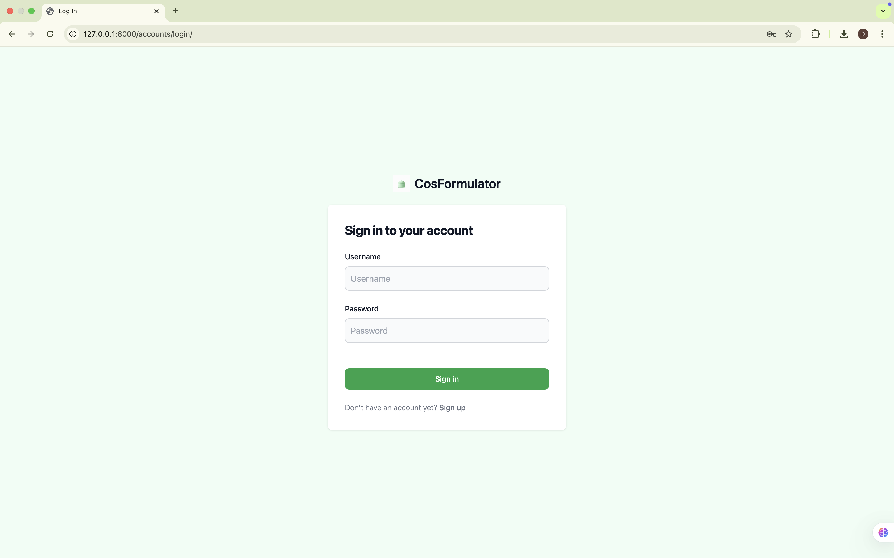
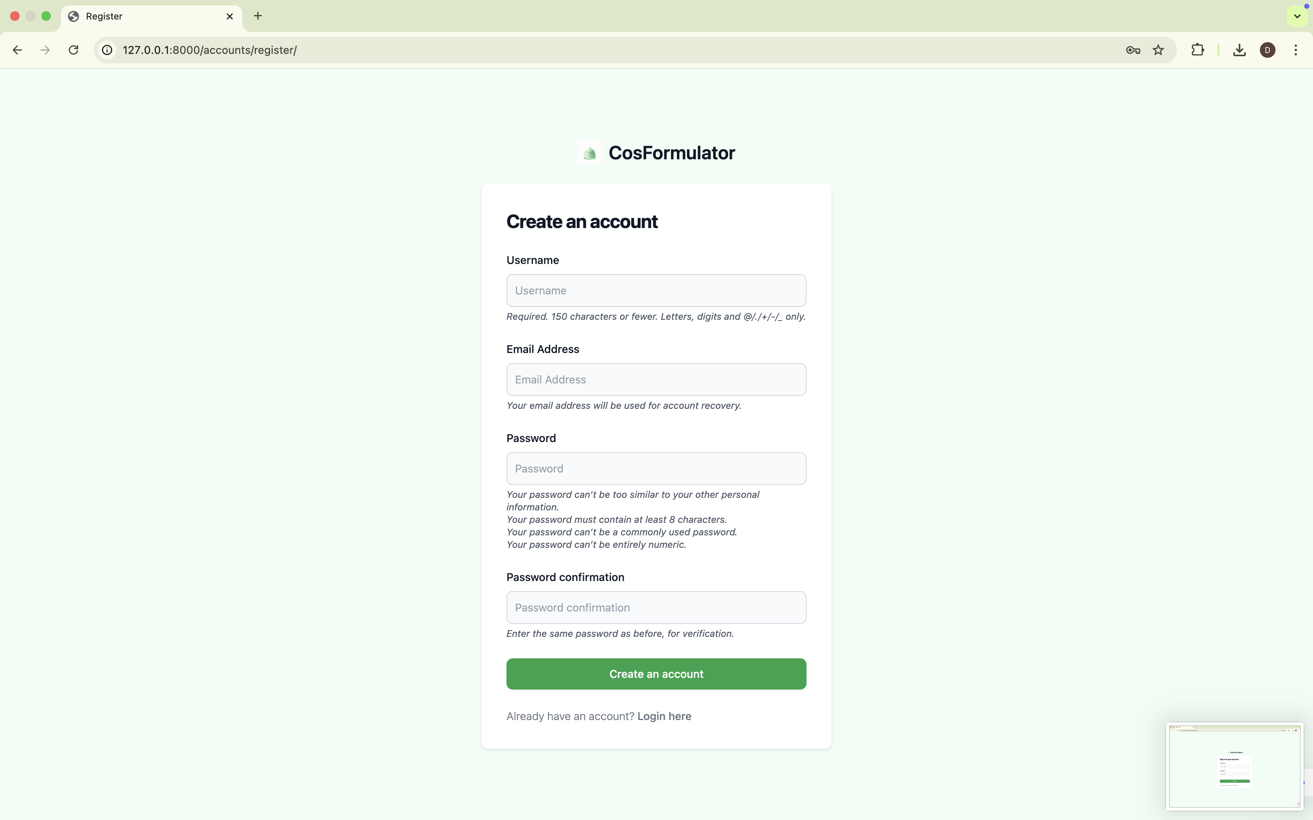
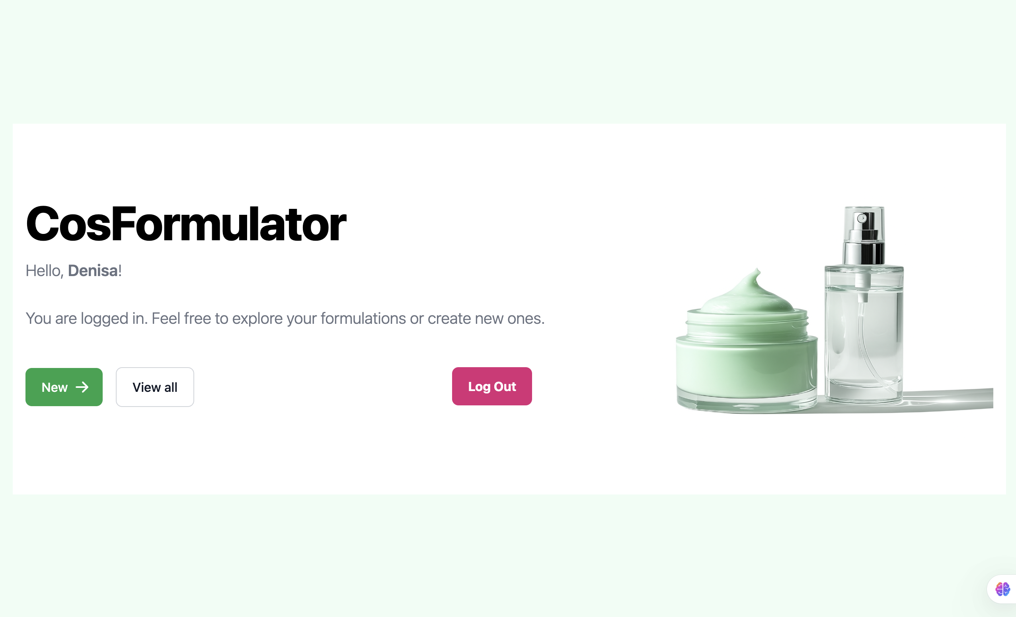
Access for authenticated users only

Slide 7
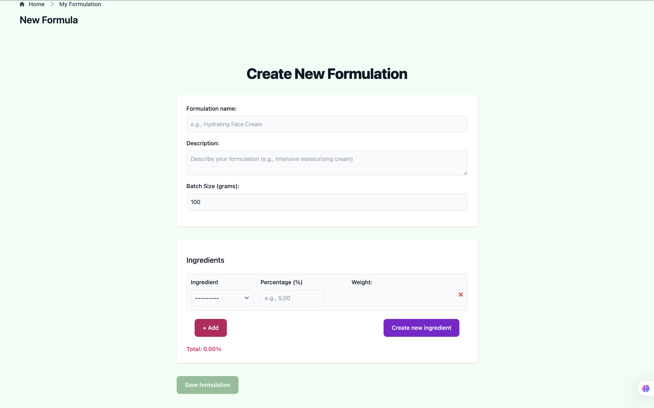
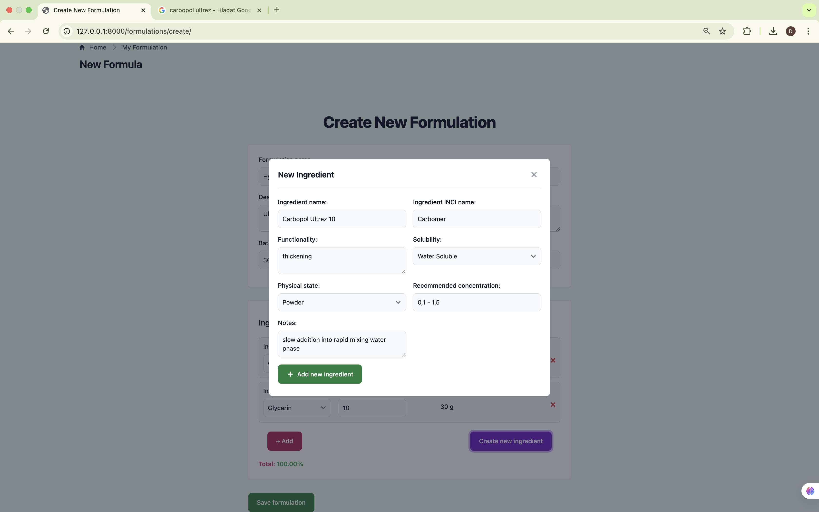
Button to add new ingredient box
Modal for creating new ingredient
Percentage safety check: unlock the save button

Slide 8
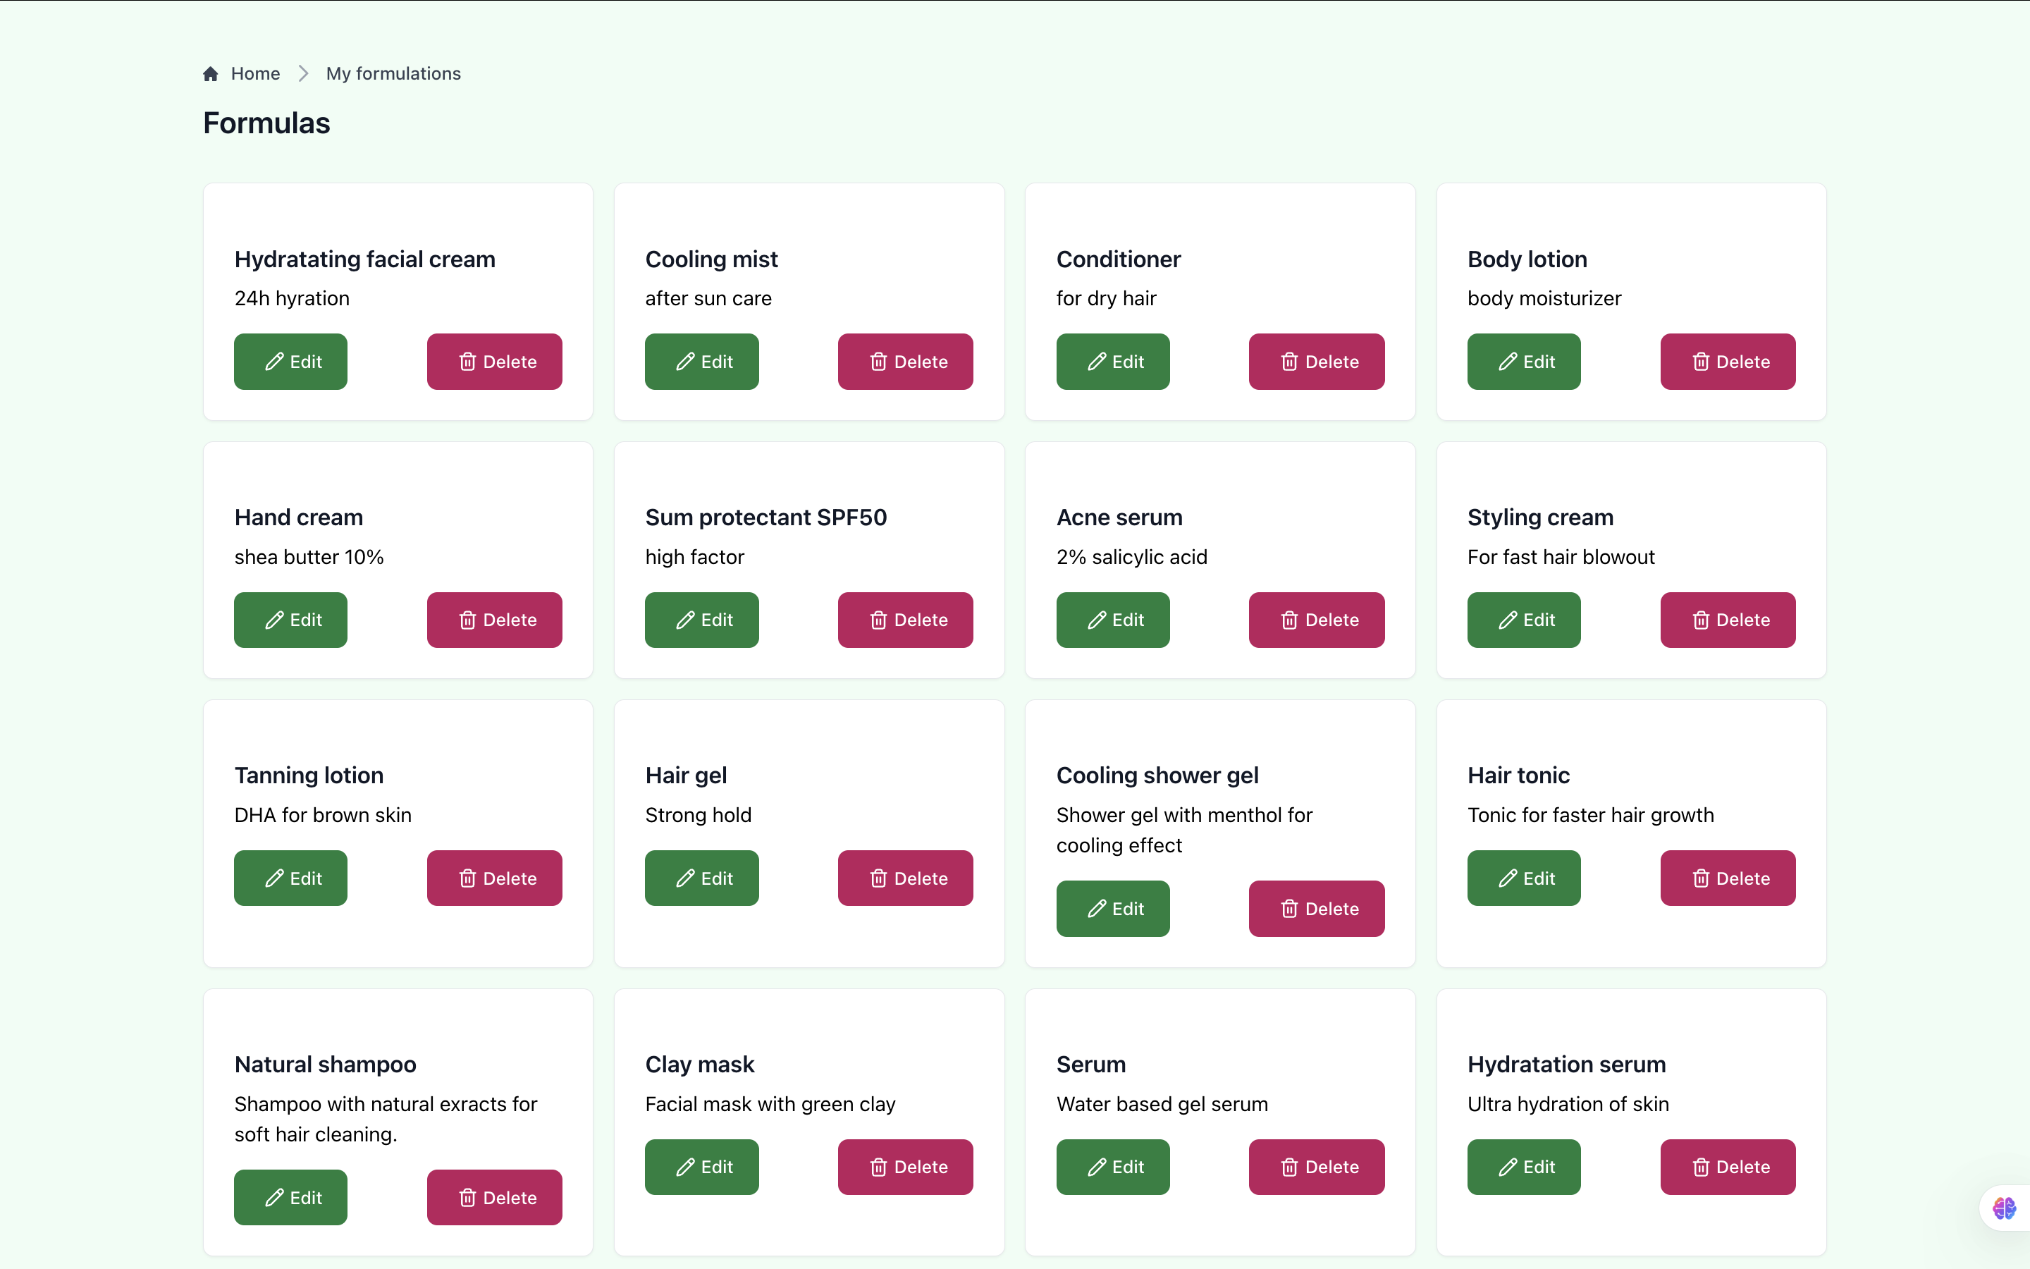
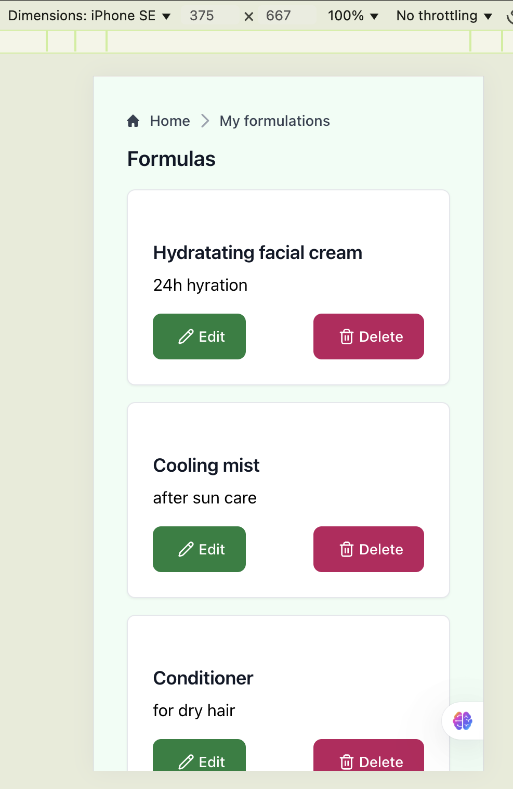
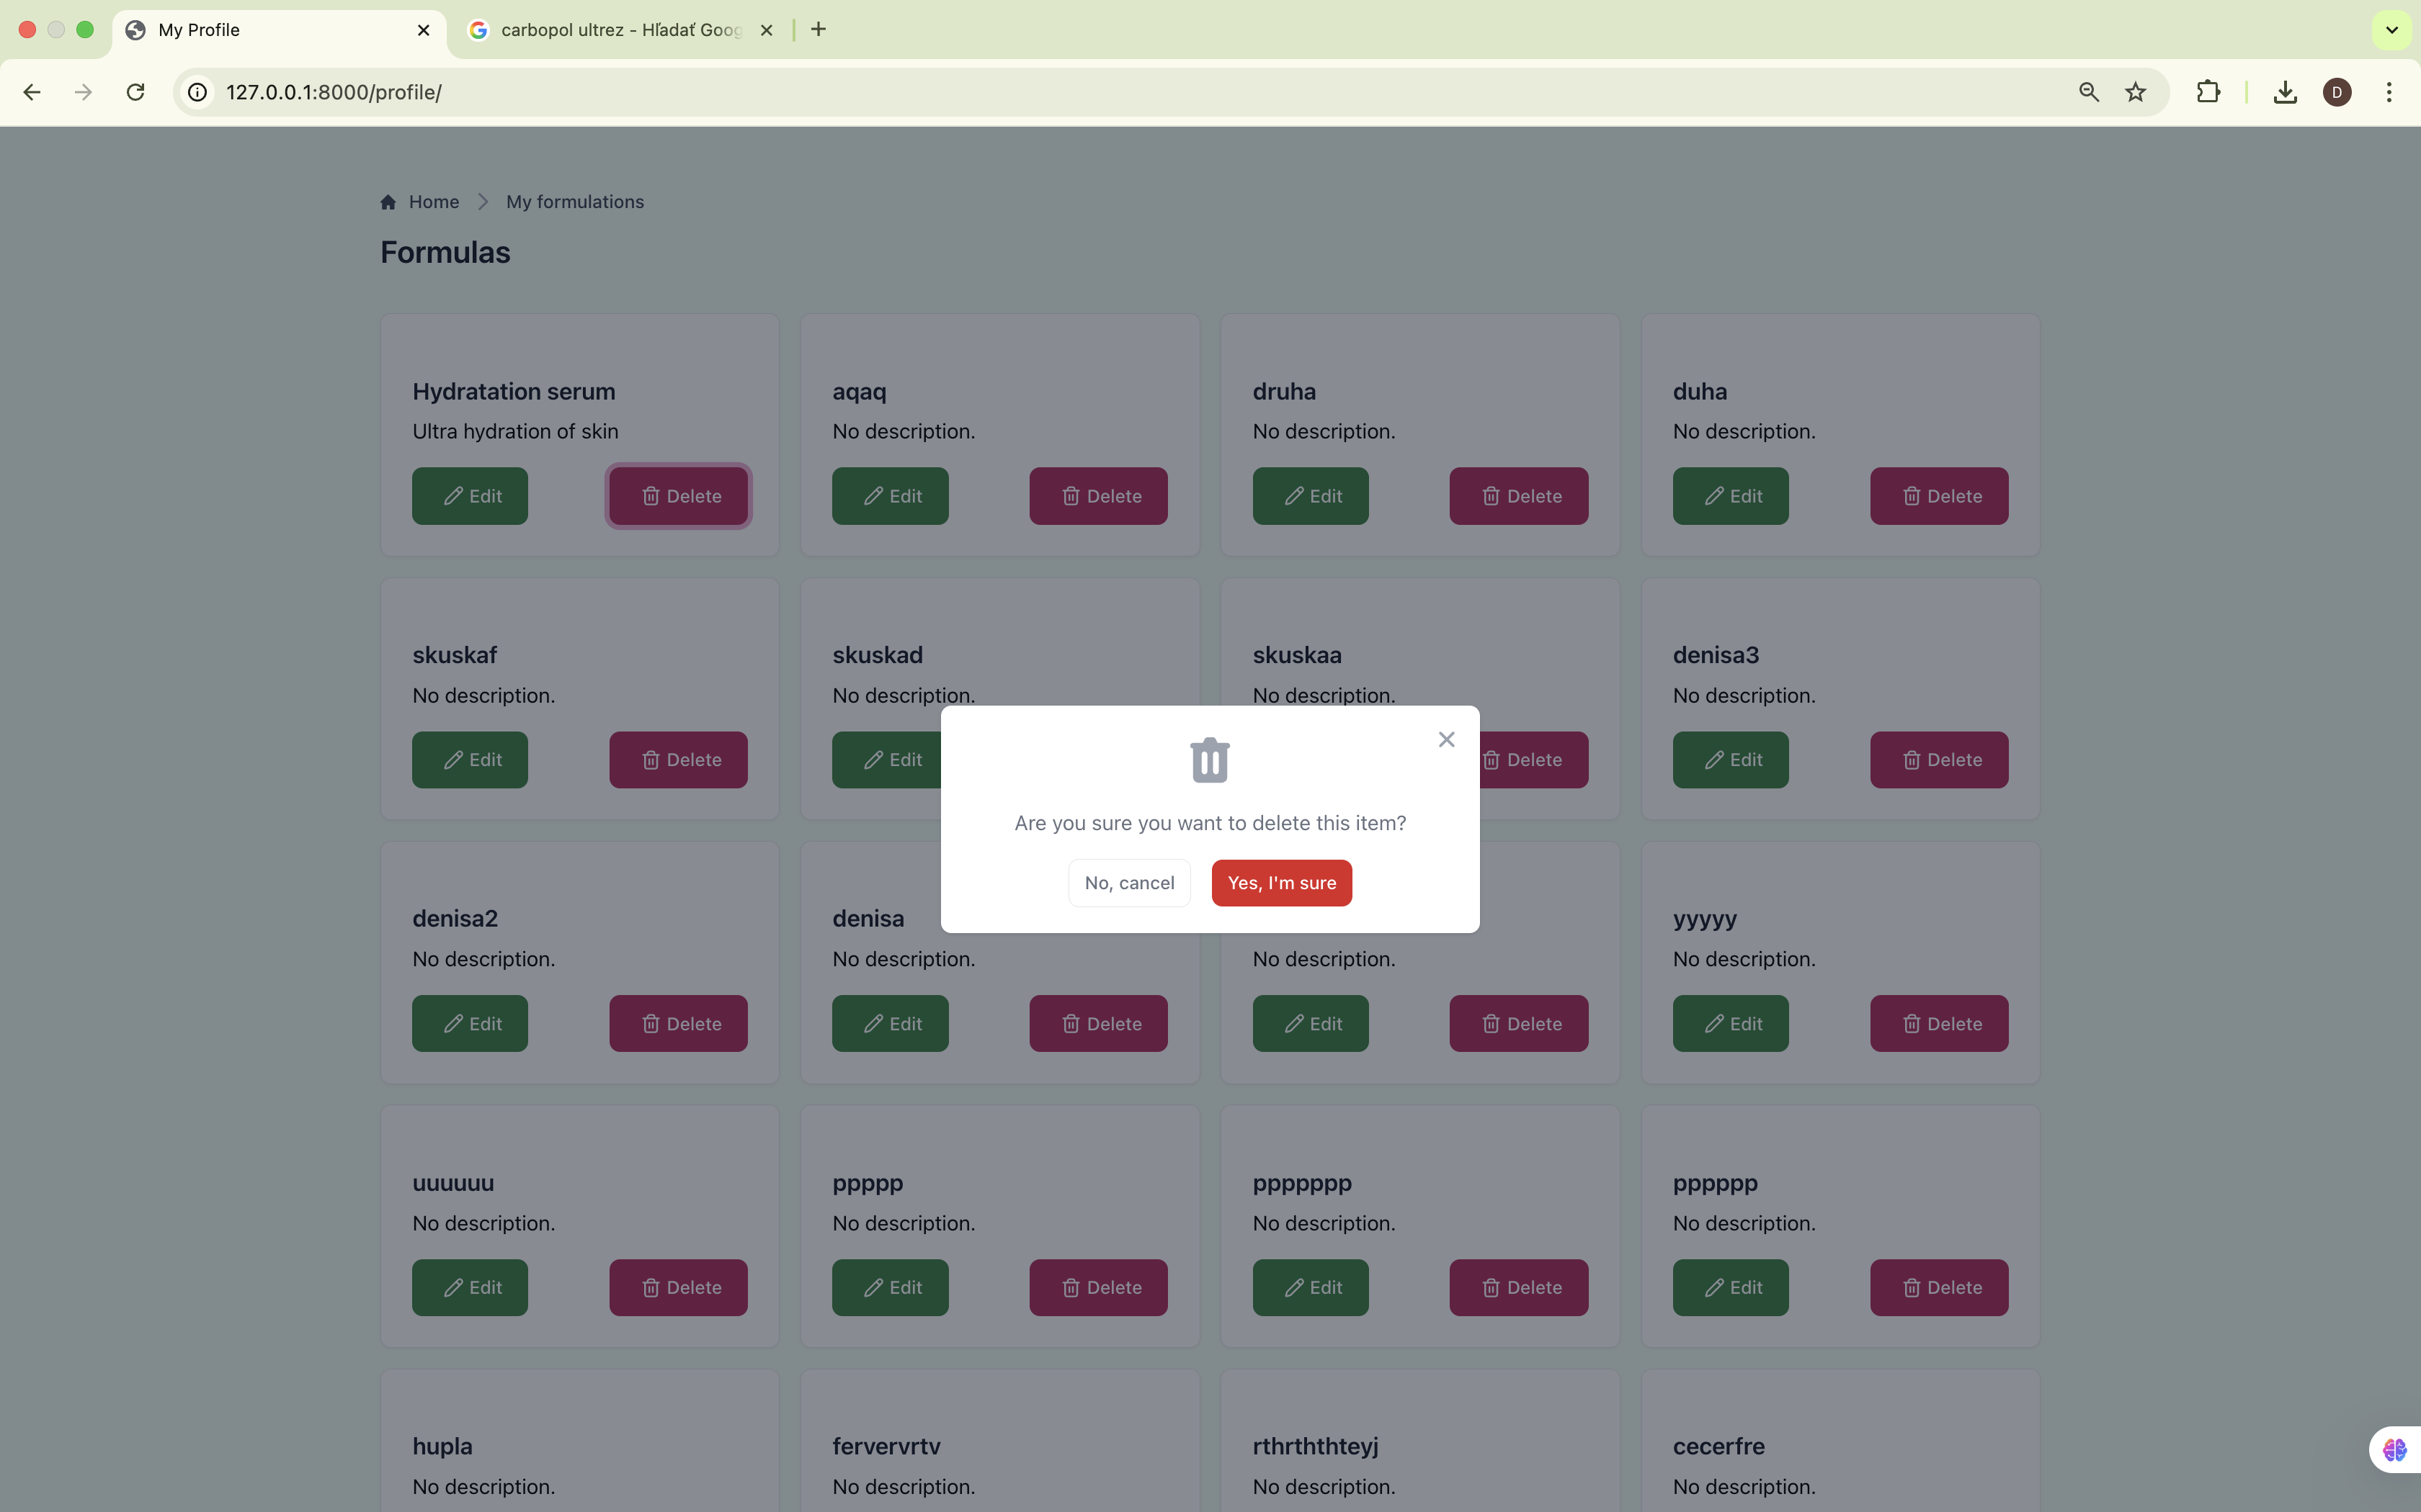
Responsive
Modal for delete

Slide 9
Test cases
Test case | Action | Expected
Test case 1: User registration (valid input) | Click a button: Sign up | New registration page is loaded.
 | Input valid information and click a button: Create an account | User profile is created, and user is logged in.
Test case 2: User registration (invalid input) | Input invalid information and click a button: Create an account | User is not registered. He is prompted to input valid information
Test case 3: User login (valid input) | Click a button: Log in | New logging page is loaded
 | Input valid credentials, click a button: Sign in | User is logged in and authenticated to manage his formulations
Test case 4: User login (invalid input) | Input invalid credentials, click a button: Sign in | User is not authenticated. He is prompted to input valid information
Test case 5: User logout | Click a button: Log out | User is logged out and he is not anymore authenticated to manage his formulations

Slide 10
Test case | Action | Expected
Test case 1: Formulation input | Click a button: New | New page is loaded with an empty form
 | Insert required information (valid) about a formulation and ingredients with their concentration (valid input) | The weight of ingredient within the formula in recalculated based on the batch size
 |  | Total percentage of all ingredients is displayed dynamically
Test case 2: Addition of a new box for ingredient input | Click a button: +Add | New box (with all input fields) for ingredient appears (no page reload)
Test case 3: Deleting an ingredient box | Click a button: X inside the box | Selected box is hidden (no page reload)
Test case 4: Creating a new ingredient | Click a button: Create new ingredient | Modal for input information appears
 | Insert information (valid), click a button: +Add new ingredient | Ingredient is saved into database, will be added to dropdown menu for ingredient selection
Test case 5: Saving formulation | Input ingredients, total percentage is not 100% | The saved button is disabled to click on it
 | Input ingredients until total percentage is 100% | The saved button is abled to click on it
 | Click a button: Save formulation | Formulation is added to the database (ingredients in deleted boxes not included)
Test case 6: Edit an existing formulation | Click a button: Edit | New page is loaded with filled form
 | Make changes and save | Formulation is updated.
Test case 7: Deleting a formula | Click a button: Delete | Modal with confirmation appears
 | Click Yes | Formulation is deleted
 | Click No | Deleted action is canceled

Slide 11
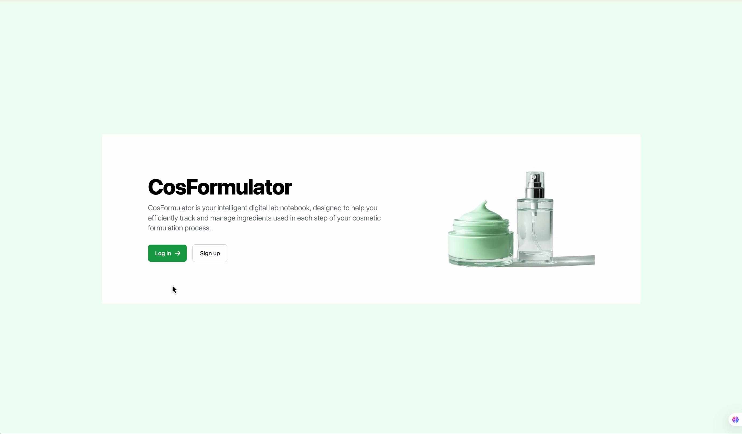
Video

